Slide 1
Transmission Impairments

Slide 2
Transmission Impairments
Transmission media is not perfect which causes signal impairments.
The signal that is received may differ from the signal that is transmitted due to various transmission impairments.
For analog signals this may degrade the signal quality.
But for digital signals ,bit errors may be introduced, i.e. 1 is transformed to 0 and vice versa.

Slide 3
Transmission Impairments
The most common impairments are
Attenuation and Attenuation distortion
Delay Distortion
Noise
This impairments may affect the information carrying capacity of a communication link.

Slide 4
Attenuation
Attenuation means loss of energy.
When a signal ,simple or composite ,travels through a medium ,it loses some of its energy in overcoming the resistance of the medium.
That is why a wire carrying electrical signals get warm or hot after a while .
Some of the electrical energy is converted into heat.
The strength of a signal falls off with distance over any transmission media.

Slide 5
Attenuation
For guided media, this reduction in strength or attenuation is generally exponential and thus is typically expressed as a constant number of decibels per unit distance.
For unguided media, attenuation is a more complex function of distance and the makeup of the atmosphere.
To compensate for this loss ,amplifiers are used to amplify the signal.
Fig 3.26 shows the effect of attenuation and amplification.

Slide 6
Attenuation

Slide 7
Attenuation
Decibels(dB)
To show whether the signal has lost or gained strength ,the unit decibel is used.
The decibel(dB) measures the relative strengths of two signals or one signal at two different points.
The decibel is negative if the signal is attenuated and positive if a signal is amplified.

Slide 8
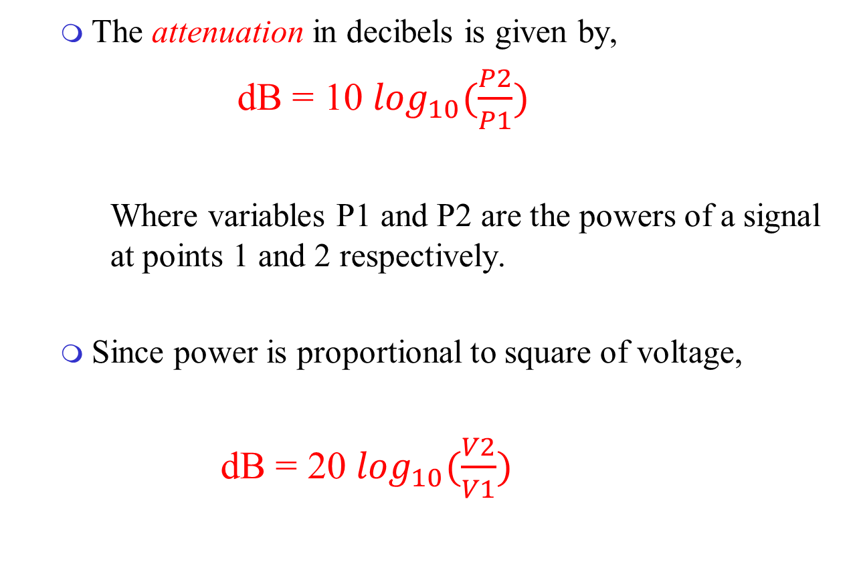
Attenuation
The attenuation in decibels is given by,
dB = 10 $\log_{10}(\frac{P2}{P1})$
Where variables P1 and P2 are the powers of a signal at points 1 and 2 respectively.
Since power is proportional to square of voltage,
dB = 20 $\log_{10}(\frac{V2}{V1})$

Slide 9
Attenuation
Attenuation introduces three considerations for transmission engineers:
A received signal must have sufficient strength so that the electronic circuitry in the receiver can detect the signal.
Signal must contain a level sufficiently higher than noise to be received without error.
Attenuation varies with frequency.

Slide 10
Attenuation
The first and second problems can be dealt with the use of amplifiers or repeaters.
In point-to-point link, the signal strength should be too strong to be received intelligibly.
For long distance, signals can be boosted by using amplifiers or repeaters at regular intervals.
But in a multipoint where the distance between transmitter and receiver is variable, this problem is much complex.

Slide 11
Attenuation
The third problem is caused in analog signals.
Since the attenuation varies with frequency, the received signal is distorted ,reducing intelligibility.
To overcome this ,Equalization technique is used, i.e. equalizing attenuation across a band of frequencies.
Commonly done in voice-grade telephone lines.
It uses loading coils that change the electrical properties of the line which result in smoothing out of attenuation effects.
Another approach is to use amplifiers that amplify high frequencies more than lower frequencies

Slide 12
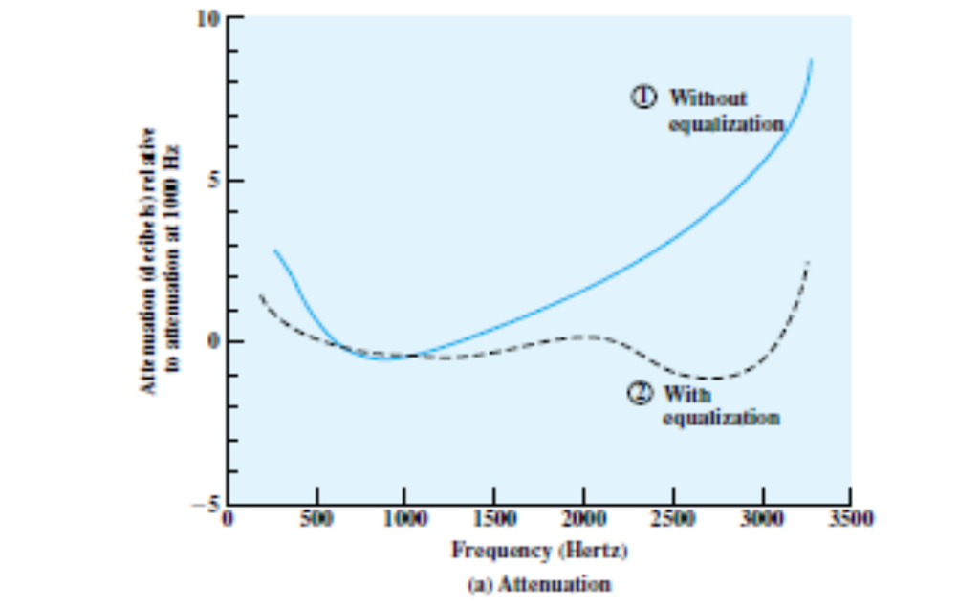
Attenuation
E.g. Attenuation as a function of frequency in a typical leased line.
Solid line shows attenuation without equalization and dashed line shows effect of equalization.

Slide 13
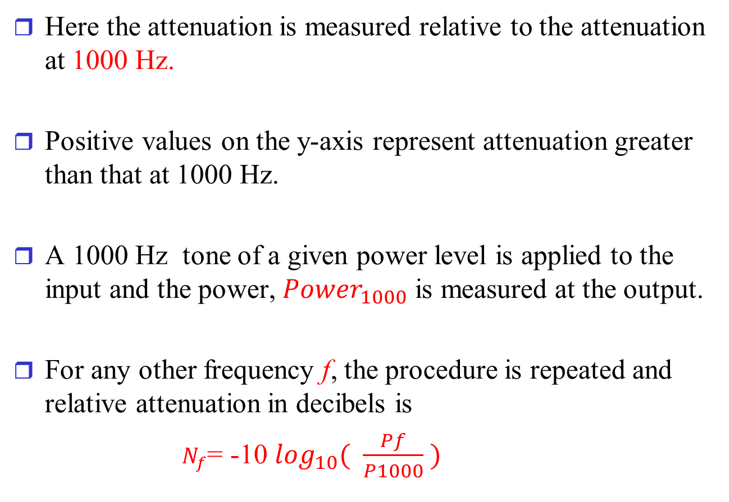
Attenuation
Here the attenuation is measured relative to the attenuation at 1000 Hz.
Positive values on the y-axis represent attenuation greater than that at 1000 Hz.
A 1000 Hz tone of a given power level is applied to the input and the power, ${Power}_{1000}$ is measured at the output.
For any other frequency f, the procedure is repeated and relative attenuation in decibels is
$N_{f}$= -10 $\log_{10}( \frac{Pf}{P1000} )$

Slide 14
Attenuation
The flattened response curve improves the quality of voice signals.
It also allows higher data rates to be used for digital data that are passed through a modem.
Attenuation distortion can present less problem with digital signals.
The strength of the digital signal falls off rapidly with frequency
But most of the content is concentrated near the fundamental frequencyof the signal.

Slide 15
Problems
1.Suppose a signal travels through a transmission medium and its power is reduced to one-half. Calculate the attenuation.

Slide 16
Problems

Slide 17
Delay distortion
Distortion means that the signal changes its form and shape.
Delay distortion occurs because the velocity of propagation of a signal through a guided medium varies with frequency.
For a band limited signal ,the velocity tends to be highest near the center frequency and fall off towards the two edges of the band.

Slide 18
Delay distortion
Thus various frequency components of a signal will arrive at the receiver at different times, resulting in phase shifts between the different frequencies.
This effect is referred to as delay distortion, because the received signal is distorted due to varying delays experienced at its constituent frequencies.

Slide 19
Delay distortion
Delay distortion is critical for digital data.
Suppose a sequence of bits are being transmitted ,using either analog or digital signals.
Because of delay distortion ,some of the signal components of one bit position will spillover into other bit position causing intersymbol interference, which is a major limitation to maximum bit rate over a transmission channel

Slide 20
Delay distortion
Distortion can occur in a composite signal made of different frequencies .
Each signal component has its own propagation speed through a medium and therefore its own delay in arriving at the final destination .
Differences in delay may create a difference in phase if the delay is not exactly the same as the period duration.
i.e. the signal components at the receiver have phases different from what they had at the sender.
The shape of the composite signal is not the same.
The effect is shown in fig.

Slide 21
Delay distortion

Slide 22
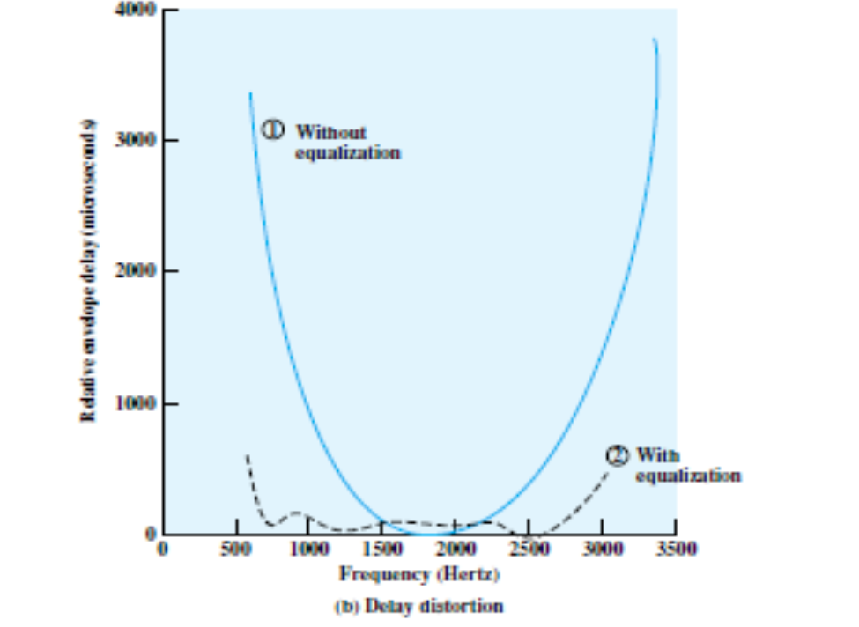
Delay distortion
Equalizing techniques can be used for delay distortion also.
The example of telephone line is shown in fig., which shows the effect of equalization on delay as a function of frequency

Slide 23
Noise
For any data transmission event, the received signal will consist of
transmitted signal, modified by various distortions imposed by transmission system plus
additional unwanted signal that are inserted somewhere between transmission and reception.
The undesired signals are referred to as Noise.
Noise is divided into four categories:
Thermal noise
Intermodulation noise
Cross talk
Impulse noise

Slide 24
Noise

Slide 25
Noise
Thermal noise
It is due to thermal agitation of electrons.
It is present in all electronic devices and transmission media .
It is a function of temperature.
Thermal noise is uniformly distributed across the bandwidth and is often referred to as white noise.
Thermal noise cannot be eliminated and therefore places an upper bound on communication system performance
Most significant in satellite communication

Slide 26
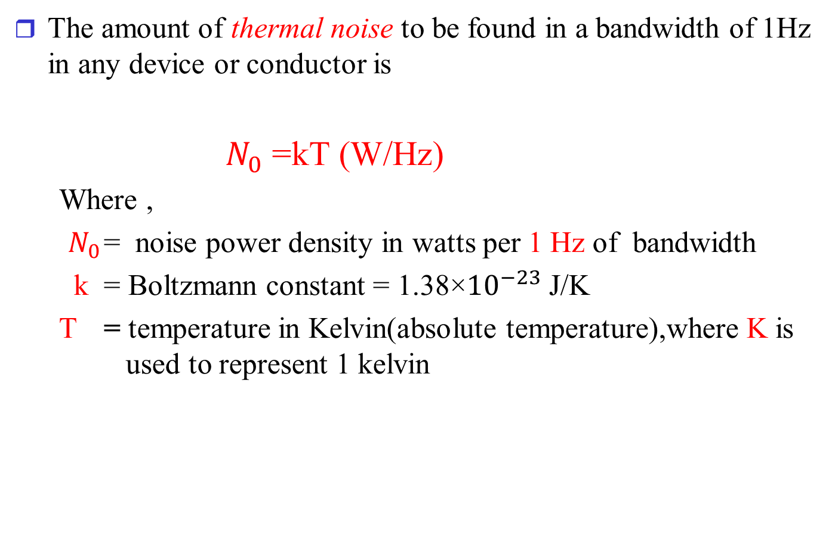
Noise
The amount of thermal noise to be found in a bandwidth of 1Hz in any device or conductor is
$N_{0}$=kT (W/Hz)
Where ,
$N_{0}$ = noise power density in watts per 1 Hz of bandwidth
k = Boltzmann constant = 1.38×${10}^{−23}$ J/K
T = temperature in Kelvin(absolute temperature),where K is used to represent 1 kelvin

Slide 27
Noise
Thus the thermal noise in watts present in a bandwidth of B hertz can be expressed as
N=kTB
Or in decibel-watts
N=10log k+10log T+10log B
=-228.6dBW+10logT+10logB

Slide 28
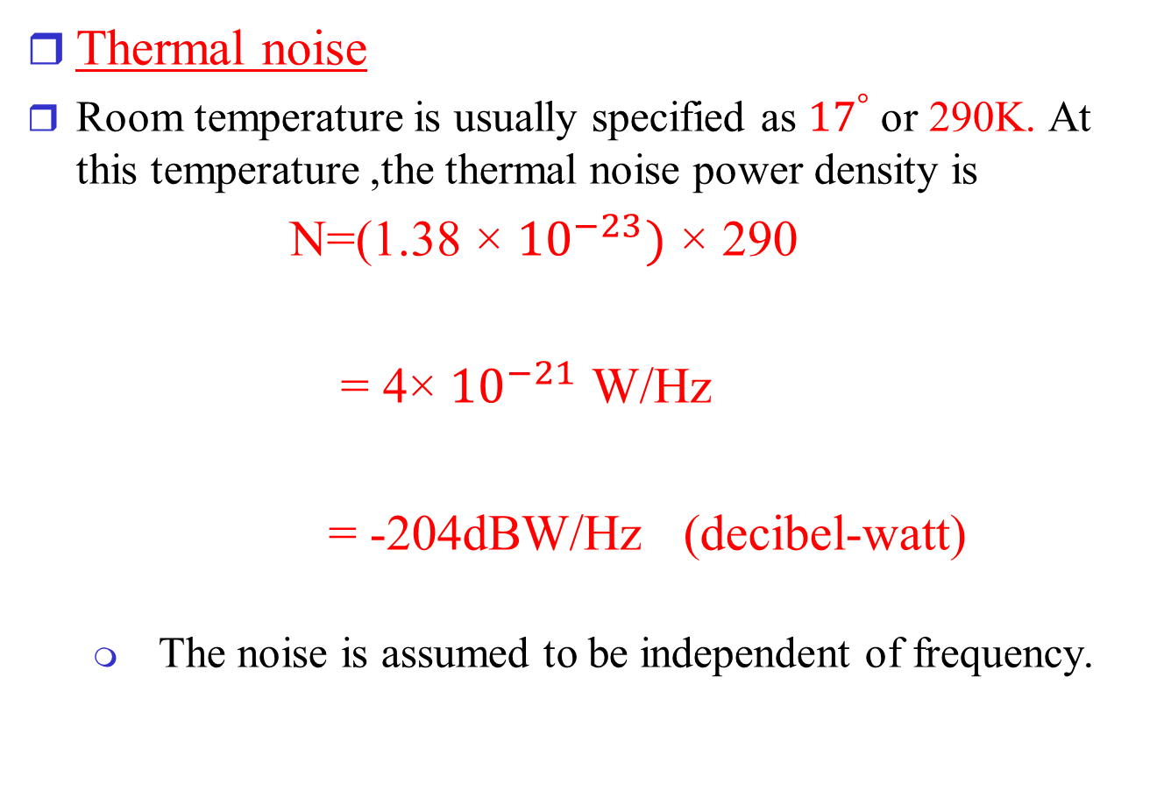
Noise
Thermal noise
Room temperature is usually specified as ${17}^{°}$ or 290K. At this temperature ,the thermal noise power density is
N=(1.38 × ${10}^{−23})$ × 290
= 4× ${10}^{−21}$ W/Hz
= -204dBW/Hz (decibel-watt)
The noise is assumed to be independent of frequency.

Slide 29
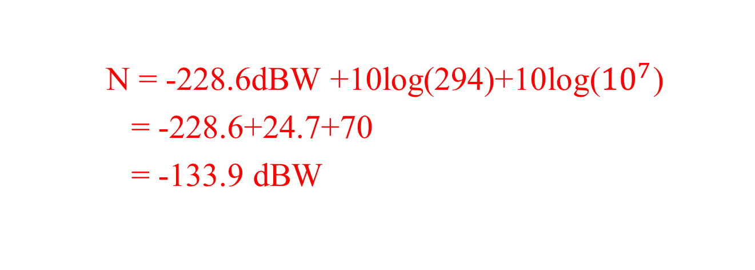
Problem
Given a receiver with an effective noise temperature of 294K and 10-MHz bandwidth, find the thermal noise level at the receiver’s output.
N = -228.6dBW +10log(294)+10log(${10}^{7}$)
= -228.6+24.7+70
= -133.9 dBW

Slide 30
Noise
Intermodulation Noise
When signals at different frequencies share the same transmission medium, the result may be intermodulation noise.
The effect of intermodulation noise is to produce signals at frequency that is the sum or difference of the two original frequencies or multiples of those frequencies.
For e.g. ,the mixing of signals at frequencies f1 and f2 might produce energy at the frequency f1+f2

Slide 31
Noise
This derived signal could interfere with an intended signal at frequency f1+ f2.
Intermodulation noise is produced by non- linearities in the transmitter, receiver or intervening transmission medium.
In ideal case , these components behaves as a linear system, i.e. the output is equal to input times a constant.
But in real system ,the output is more complex function of the input.

Slide 32
Noise
Non-linearity is due to component malfunction or overload from excessive signal strength.
At these circumstances sum and difference frequency terms occur.

Slide 33
Noise
Cross Talk
It can be experienced while using telephone i.e. we can hear another conversation.
It is an unwanted coupling between signal paths.
It can occur by electrical coupling between nearby twisted pairs or rarely coax cable lines carrying multiple signals.
Cross talks can also occur when microwave antennas pick up unwanted signals.

Slide 34
Noise
Impulse Noise
Is non-continuous, consisting of irregular pulses or noise spikes of short duration and of relatively high amplitude.
It is generated from a variety of causes ,including external electromagnetic disturbances ,such as lighting and faults and flaws in the communication system.
It is of less importance in analog data .
For e.g. voice may be corrupted in short clicks with no loss of intelligibility.
But it is the primary source of error in digital data communication

Slide 35
Effect of noise on channels

Slide 36
Channel Capacity
The maximum rate at which data can be transmitted over a given communication path, or channel ,under given conditions is referred to as channel capacity.

Slide 37
Channel Capacity
Four concepts in data communication:
Data rate
The rate ,in bits per second(bps)at which data can be communicated.
Bandwidth
The bandwidth of the transmitted signal as constrained by the transmitter and the nature of transmission medium, expressed in cycles/second or Hertz
Noise
The average level of noise over the communication path
Error rate
The rate at which errors occur, where an error is the reception of a 1 when a 0 is transmitted or the reception of a 0 when a 1 was transmitted.

Slide 38
Channel Capacity
In data communication , a very important consideration is how fast we can send data, in bits per second, over a channel.
For a digital data, high data rate is preferred at a particular limit of error rate for a given bandwidth.
The main constraint in achieving this efficiency is noise.
The data rate depends on three factors:
The bandwidth available
The level of signal we use
The quality of the channel(i.e. the level of noise)

Slide 39
Channel Capacity
Two theoretical formulas were developed to calculate the data rate :
Nyquist Bandwidth (for noiseless channel)
Shannon Capacity Formula (for noisy channel)

Slide 40
Channel Capacity
Nyquist Bandwidth(Noiseless channel)
In this environment the limitation on data rate is simply the bandwidth of the signal.
If the signals to be transmitted are binary(two voltage signals),then the data rate that can be supported by B Hz is 2B bps
Signals can have more than two levels i.e each signal element can represent more than one bit.
For four voltage level,each signal element can represent 2 bits.

Slide 41
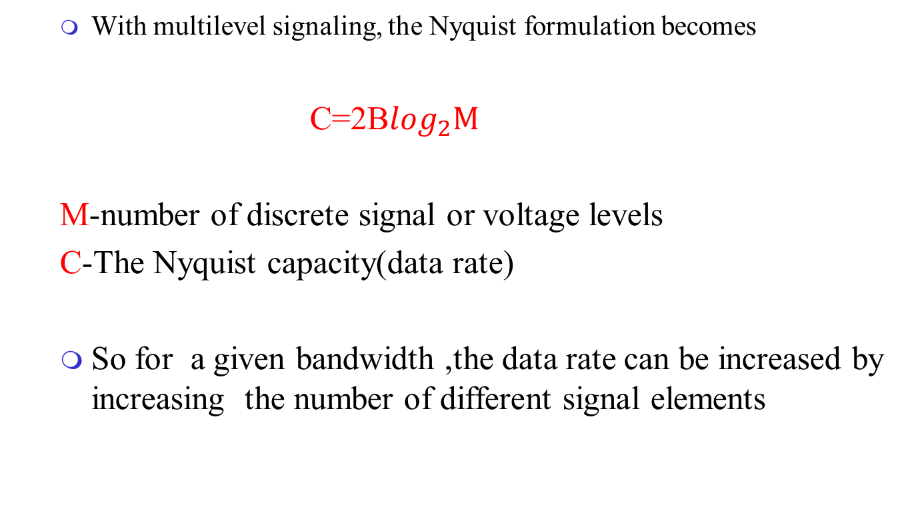
Channel Capacity
With multilevel signaling, the Nyquist formulation becomes
C=2B$\log_{2}M$
M-number of discrete signal or voltage levels
C-The Nyquist capacity(data rate)
So for a given bandwidth ,the data rate can be increased by increasing the number of different signal elements

Slide 42

Problem
1. Consider a noiseless channel with a bandwidth of 3000Hz transmitting signal with two signal levels. Calculate the maximum bit rate.
Bit rate ,C=2B$\log_{2}M$
=2×3000×$\log_{2}$2
=6000 bps

Slide 43

Problem
2.Consider the same noiseless channel transmitting a signal with four signal levels(for each level we send 2 bits).what is the maximum bit rate..
Bit rate ,C=2B$\log_{2}M$
=2×3000×$\log_{2}4$
=12,000 bps

Slide 44
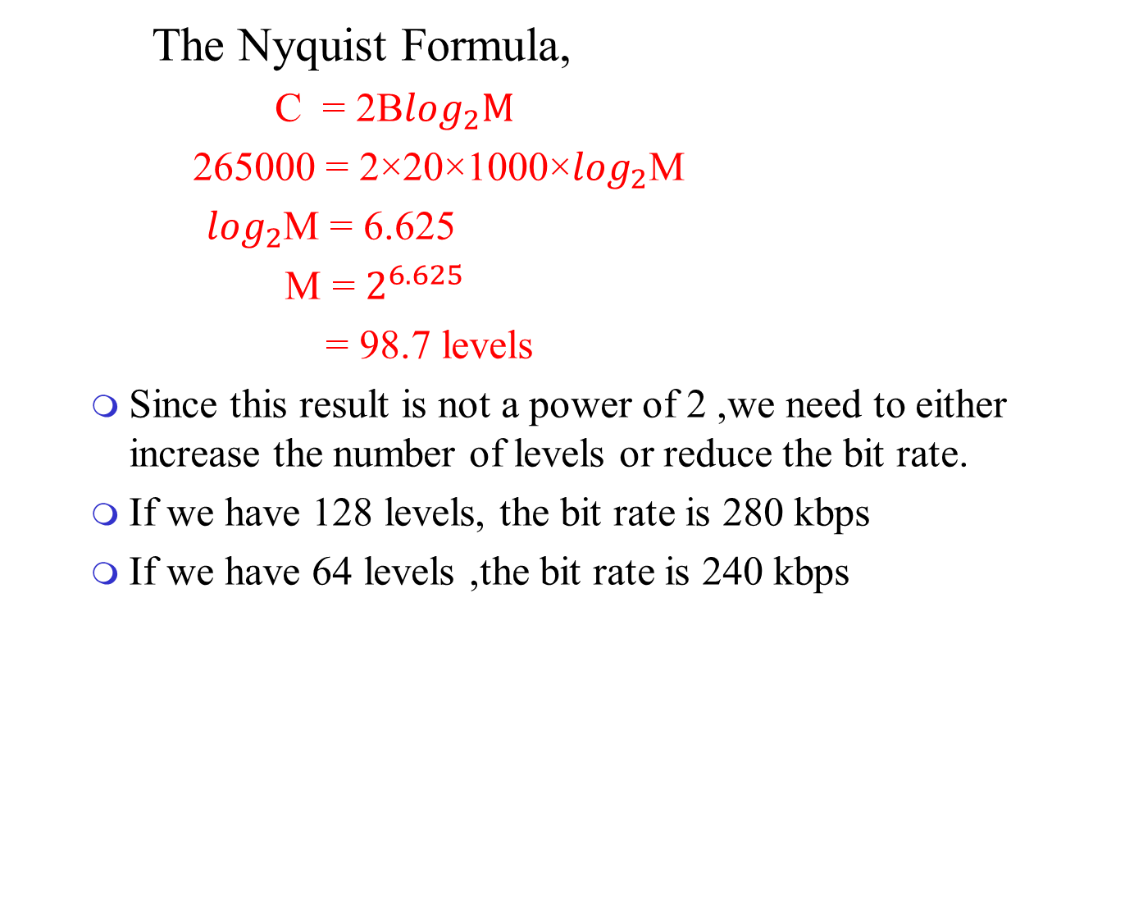
Problem
3.We need to send 265 kbps over a noiseless channel with a bandwidth of 20kHz.How many signal levels do we need?
The Nyquist Formula,
C = 2B$\log_{2}M$
265000 = 2×20×1000×$\log_{2}$M
$\log_{2}$M = 6.625
M = $2^{6.625}$
= 98.7 levels
Since this result is not a power of 2 ,we need to either increase the number of levels or reduce the bit rate.
If we have 128 levels, the bit rate is 280 kbps
If we have 64 levels ,the bit rate is 240 kbps

Slide 45
Channel Capacity
Shannon Capacity formula(for Noisy channels)
The data rate ,noise and error rate are related .
The presence of noise can corrupt one or more bits.
If the data rate is increased ,then the bits become shorter so that more bits are affected by a given pattern of noise.
i.e. the higher the data rate the more damage that unwanted noise can do.
For a given level of noise, we would expect that a greater signal strength would improve the ability to receive data correctly in the presence of noise.

Slide 46
Channel Capacity
The key parameter involved in this reasoning is signal-to-noise ratio(SNR)
Signal-to-noise ratio(SNR): is the ratio of the power in signal to the power contained in the noise that is present at a particular point in the transmission.
This ratio is measured at the receiver, because it is at this point that an attempt is made to process the signal and recover the data.

Slide 47
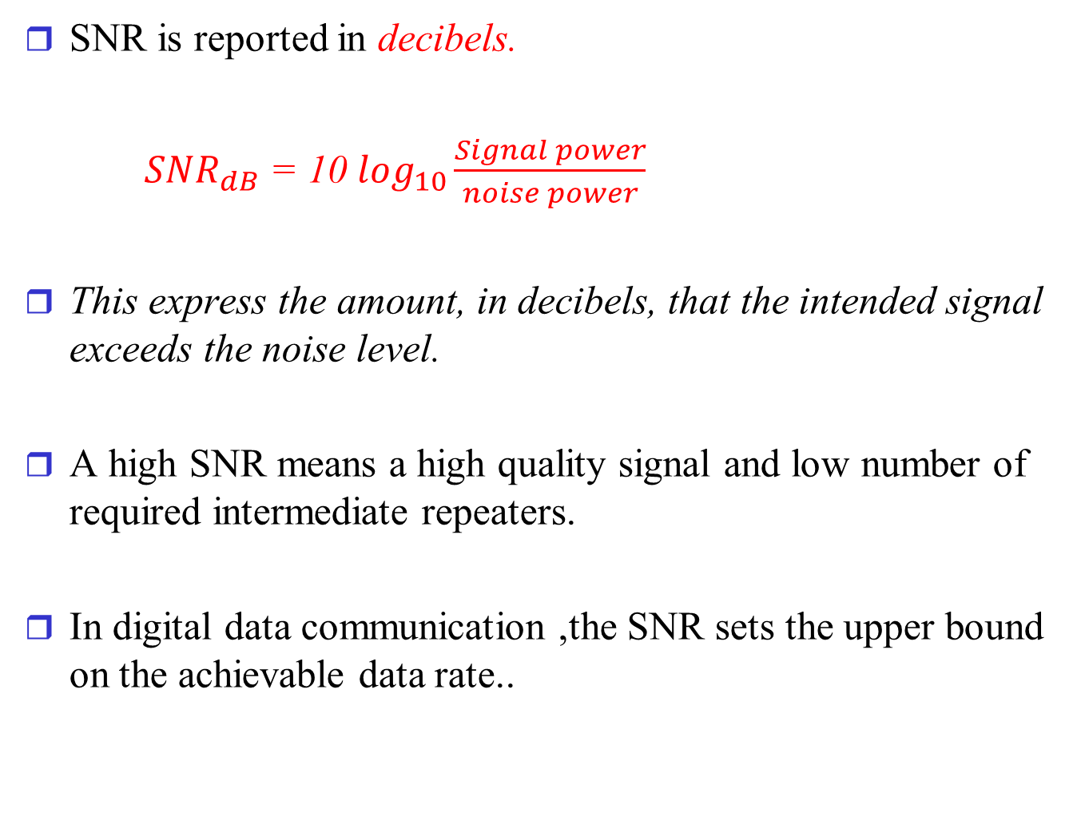
Channel Capacity
SNR is reported in decibels.
${SNR}_{dB}$ = 10 $\log_{10}\frac{Signal power}{noise power}$
This express the amount, in decibels, that the intended signal exceeds the noise level.
A high SNR means a high quality signal and low number of required intermediate repeaters.
In digital data communication ,the SNR sets the upper bound on the achievable data rate..

Slide 48
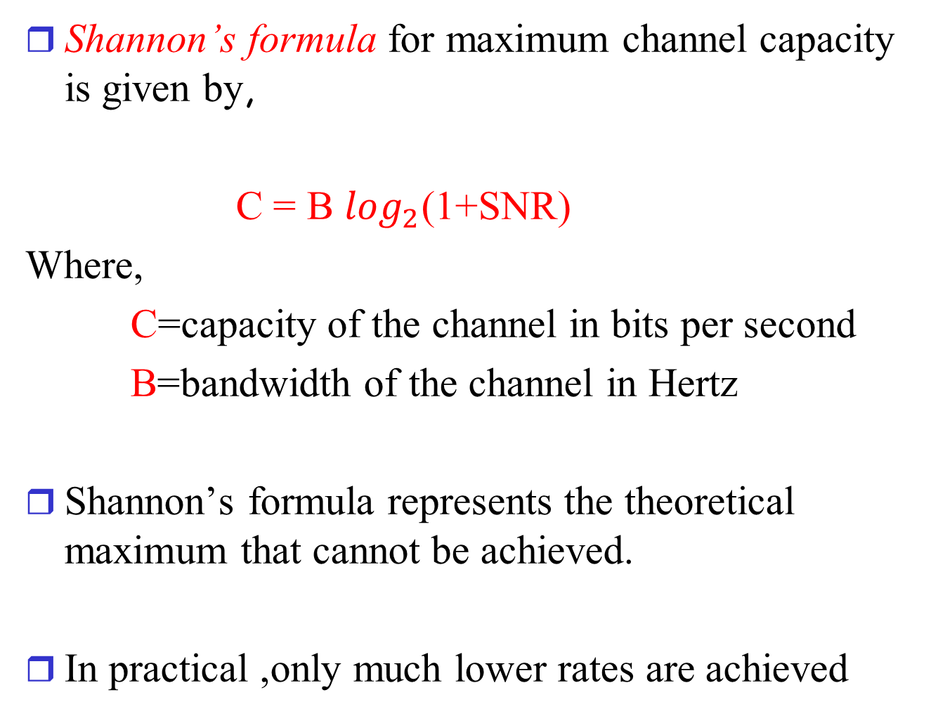
Channel Capacity
Shannon’s formula for maximum channel capacity is given by,
C = B $\log_{2}$(1+SNR)
Where,
C=capacity of the channel in bits per second
B=bandwidth of the channel in Hertz
Shannon’s formula represents the theoretical maximum that cannot be achieved.
In practical ,only much lower rates are achieved

Slide 49
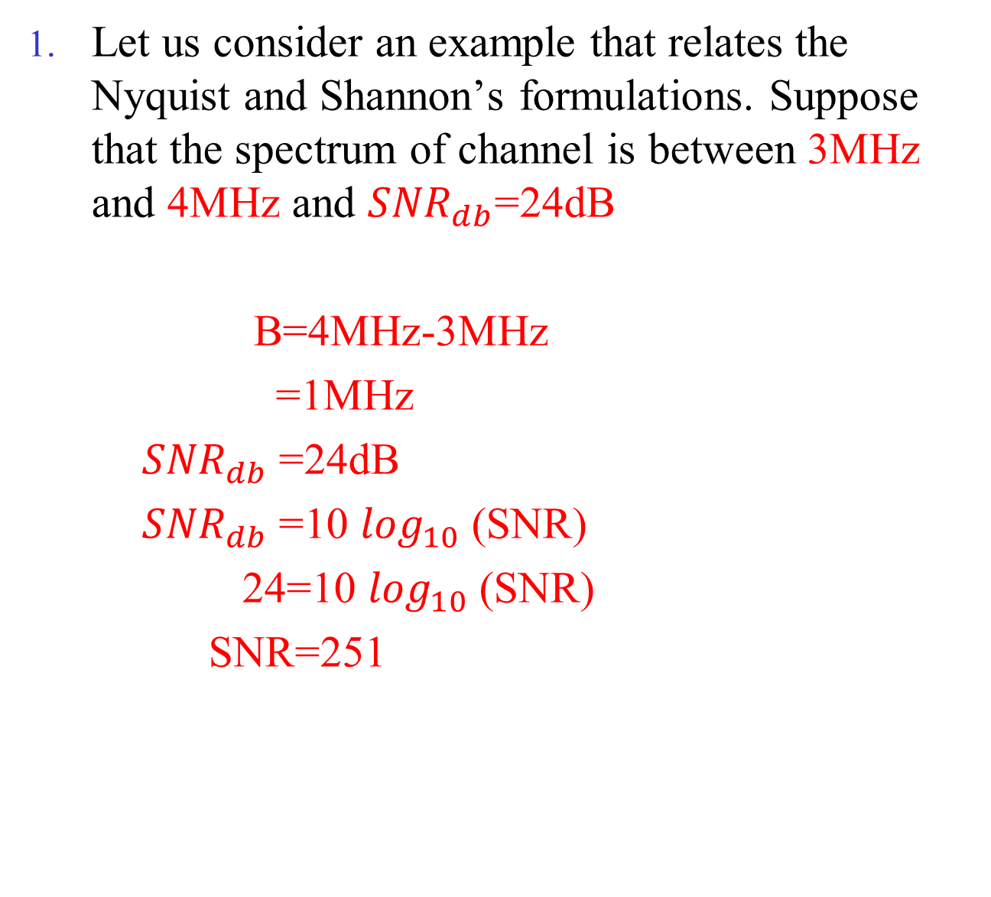
Problem
Let us consider an example that relates the Nyquist and Shannon’s formulations. Suppose that the spectrum of channel is between 3MHz and 4MHz and ${SNR}_{db}$=24dB
B=4MHz-3MHz
=1MHz
${SNR}_{db}$=24dB
${SNR}_{db}$=10 $\log_{10}⁡$(SNR)
24=10 $\log_{10}⁡$(SNR)
SNR=251

Slide 50
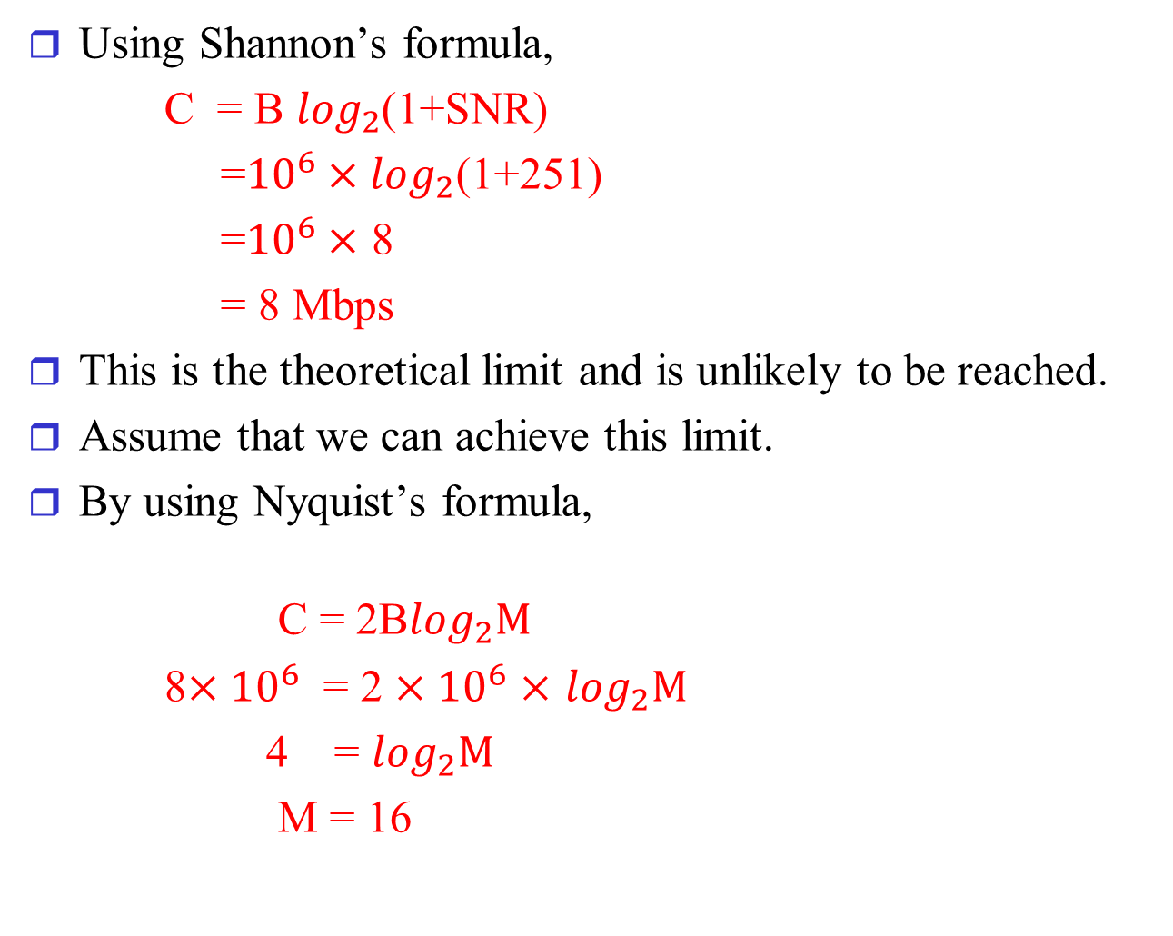
Problem
Using Shannon’s formula,
C = B $\log_{2}$(1+SNR)
=${10}^{6}×\log_{2}$(1+251)
=${10}^{6}×$ 8
= 8 Mbps
This is the theoretical limit and is unlikely to be reached.
Assume that we can achieve this limit.
By using Nyquist’s formula,
C = 2B$\log_{2}M$
8$×{10}^{6}$ = 2 $×{10}^{6}$ $×$ $\log_{2}M$
4 = $\log_{2}M$
M = 16

Slide 51
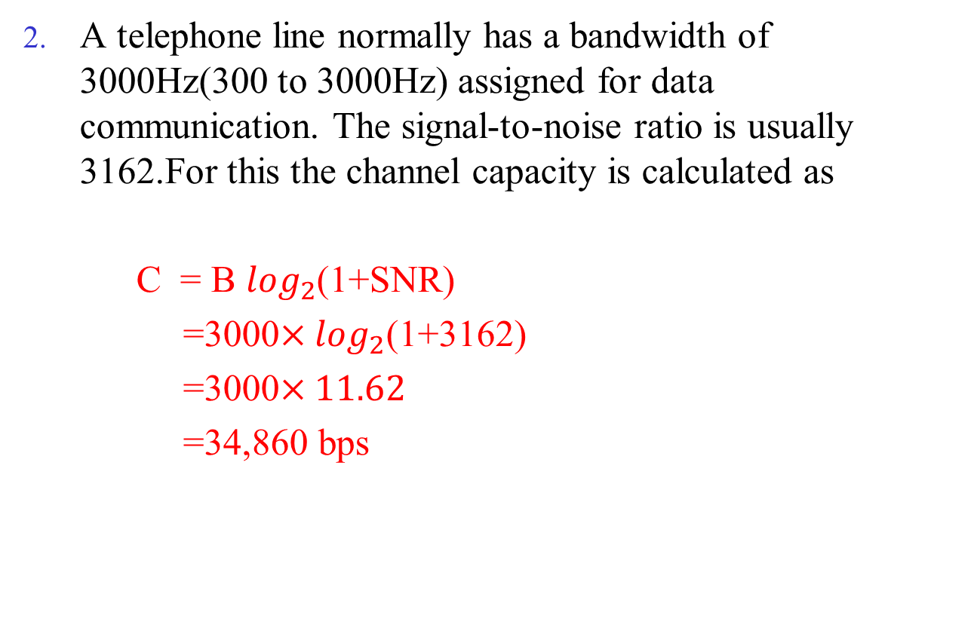
Problem
A telephone line normally has a bandwidth of 3000Hz(300 to 3000Hz) assigned for data communication. The signal-to-noise ratio is usually 3162.For this the channel capacity is calculated as
C = B $\log_{2}$(1+SNR)
=3000$×\log_{2}$(1+3162)
=3000$×11.62$
=34,860 bps

Slide 52
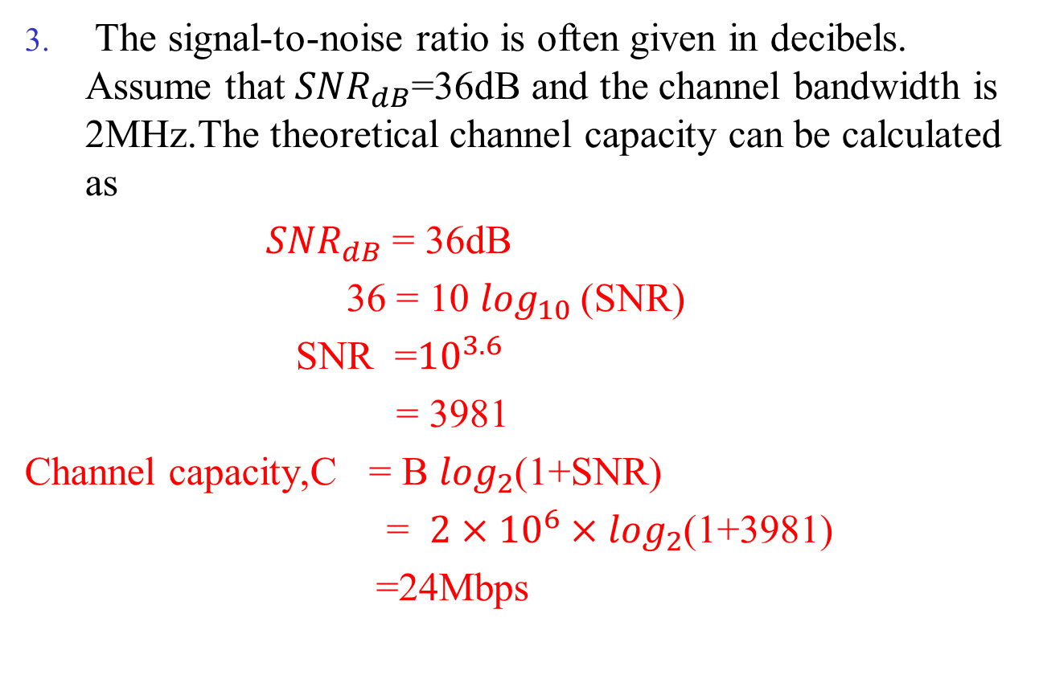
Problem
The signal-to-noise ratio is often given in decibels. Assume that ${SNR}_{dB}$=36dB and the channel bandwidth is 2MHz.The theoretical channel capacity can be calculated as
${SNR}_{dB}$ = 36dB
36 = 10 $\log_{10}⁡$(SNR)
SNR =${10}^{3.6}$
= 3981
Channel capacity,C = B $\log_{2}$(1+SNR)
= $2×{10}^{6}×\log_{2}$(1+3981)
=24Mbps

Slide 55
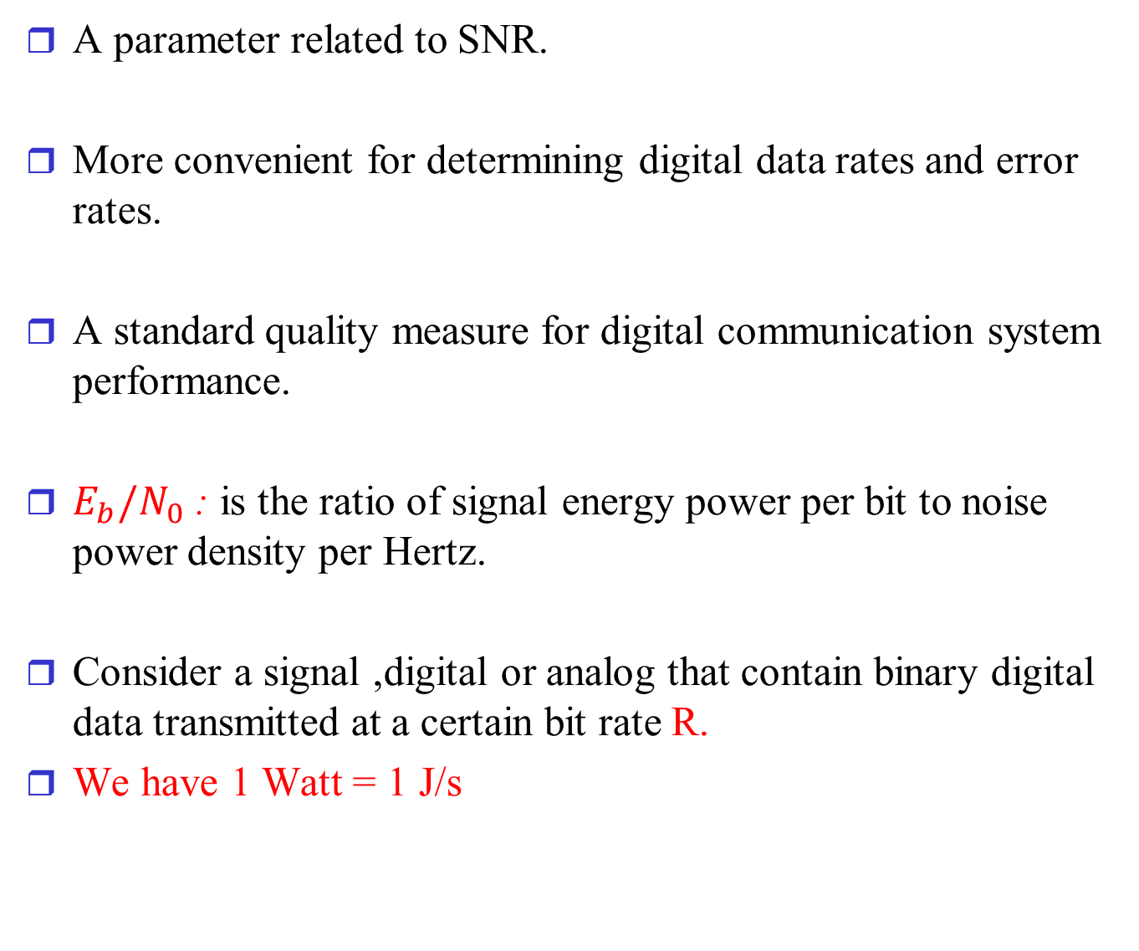

The Expression $E_{b}/N_{0}$
A parameter related to SNR.
More convenient for determining digital data rates and error rates.
A standard quality measure for digital communication system performance.
$E_{b}/N_{0}$ : is the ratio of signal energy power per bit to noise power density per Hertz.
Consider a signal ,digital or analog that contain binary digital data transmitted at a certain bit rate R.
We have 1 Watt = 1 J/s

Slide 56
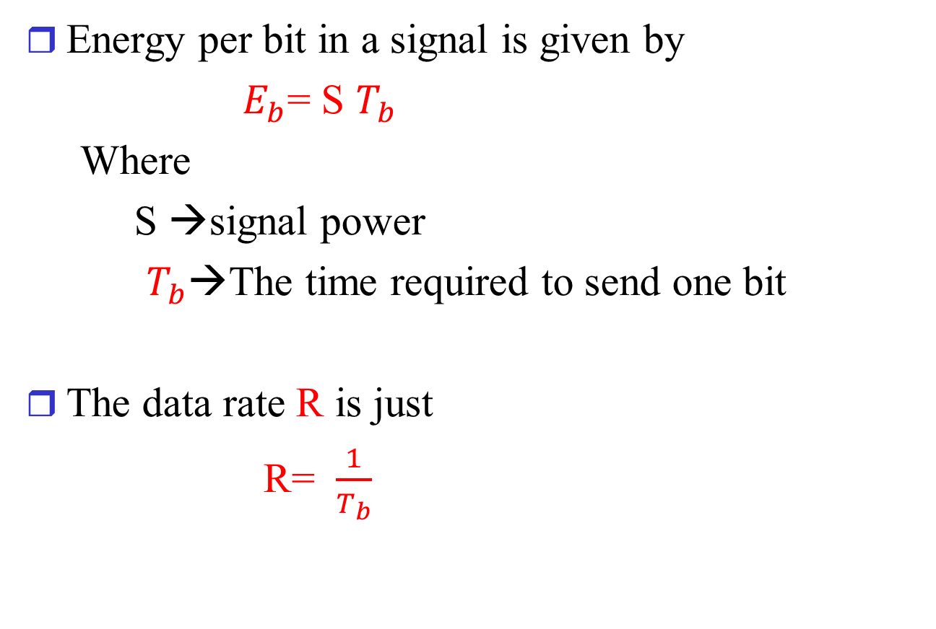

The Expression $E_{b}/N_{0}$
Energy per bit in a signal is given by
$E_{b}$= S $T_{b}$
Where
S →signal power
$T_{b}$→The time required to send one bit
The data rate R is just
R= $\frac{1}{T_{b}}$

Slide 57
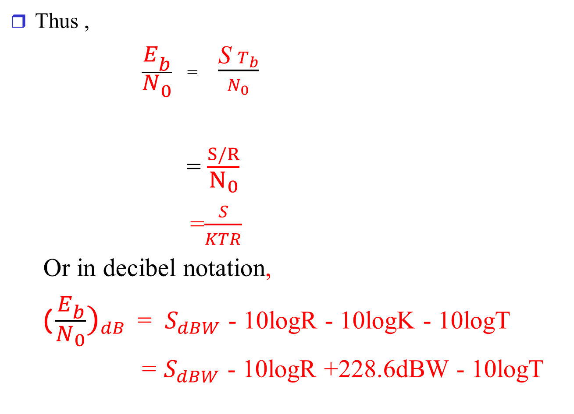
The Expression $E_{b}/N_{0}$
Thus ,
$\frac{E_{b}}{N_{0}}$ = $\frac{\text{S} T_{b}}{N_{0}}$
= $\frac{S/R}{N_{0}}$
=$\frac{S}{KTR}$
Or in decibel notation,
(${ \frac{E_{b}}{N_{0}})}_{dB}$= $S_{dBW}$ - 10logR - 10logK - 10logT
= $S_{dBW}$ - 10logR +228.6dBW - 10logT

Slide 58


The Expression $E_{b}/N_{0}$
The ratio $E_{b}/N_{0}$ is important because the bit error rate for digital data is a function of this ratio.
The advantage of $E_{b}/N_{0}$ over SNR is that SNR depends on the bandwidth.

